Slide 1
Generalized N-Body Solvers in the Physical and Information Sciences
Matt Challacombe, Nicolas Bock, Jean Challacombe & Terry Haut
Los Alamos National Laboratory
matt.challacombe@freeon.org
“New Algorithms for Complex Data” March 19th-20th
LA-UR-15-21677
Sponsored by: DOE LDRD-ER grant 20110230ER & TenBar Café

Slide 2
N-Body Solvers in the Physical, Information & Computer Sciences
N-Body solvers combine database operations (range & metric queries) with locality preserving heuristics and a wide variety of mathematical approximations. Examples: the astrophysical Barnes-Hut tree-code, the Fast Gauss Transform and so on.
The generic n-body model has been extended to a vast number of fast, pairwise (kernel) summation techniques in the information sciences. Examples: see www.fast-lab.org.
In functional programming, the n-body problem may be developed with the formal properties of generacity, involving map, fold, reduce & etc. Examples: the parallel map skeleton, algorithmic skeleton frameworks and so on.

Slide 3
N-Body Solvers You May Know
Hydrodynamics
Plasmas,
Biophysics & Materials Science
Astrophysics
Octree Meshing
Graviational N-Body
Fast Poisson Solvers
N-Body
Solvers
Visualization, game physics, rigid body simulation
Fast occlusion and culling
Quantum N-Body Solvers
Electronic Structure
Statistical Leaning
Fast Linear Algebra
Fast Gauss Transform
Proximity Problems, N-point Correlation Functions, RBF neural networks
Inverse Factorization, Semi-Definite Programming, Spectral Projection, Machine Learning
Plasmas, High Dimensional Kernel Density Estimation, Options Pricing, Heat Equations

Slide 4
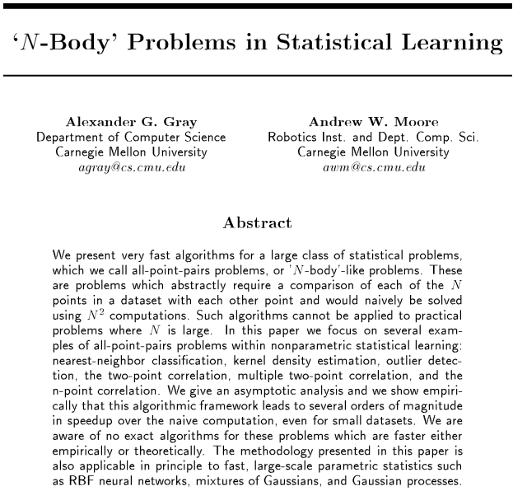
Massively popularized the generalized n-body problem in the information sciences

Slide 5
Why N-Body Algorithms for Complex Data?
Alignment with enterprise “big data” hardware and software trends: n-body is MapReduce.
Potential for extreme simplicity and interoperability in complex scientific applications, eg. electronic structure.
Supported by well developed, simple and commonly available runtime systems such as openmp.
New mathematical and computational science breakthroughs through focus on data locality.

Slide 6
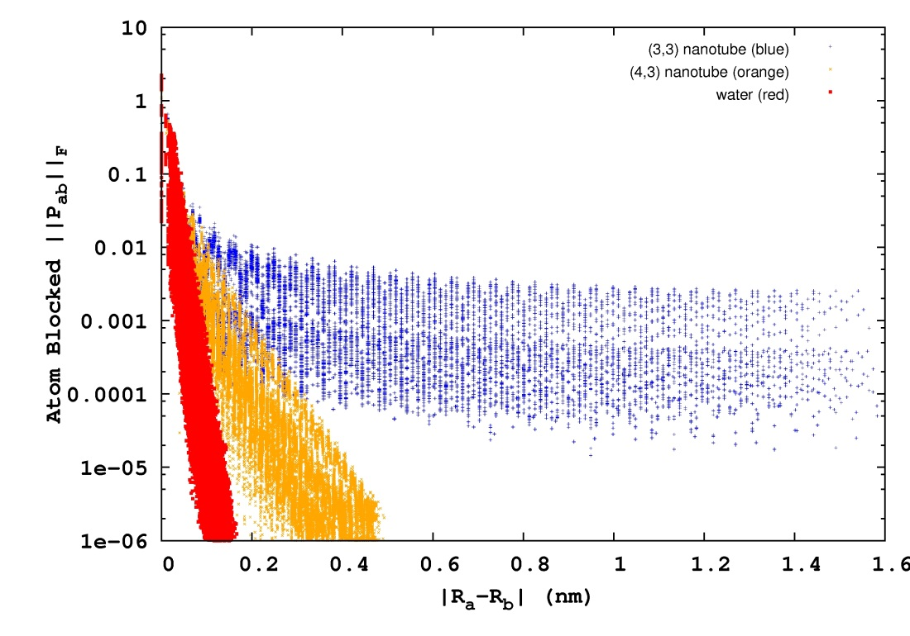
Locality, Decay & Kohn’s Nearsighted Principle
water
semi-conducting nanotube
metallic nanotube
Quantum matrices possess decay properties due to the finite range of quantum interactions for non-metallic systems.
We are interested in systems with metric (basis) and gap ill-conditioning, leading to slow rates of decay. These problems occur with accurate methods and for problems involving strong correlation.

Slide 7
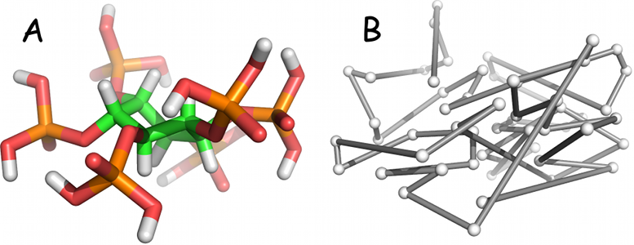
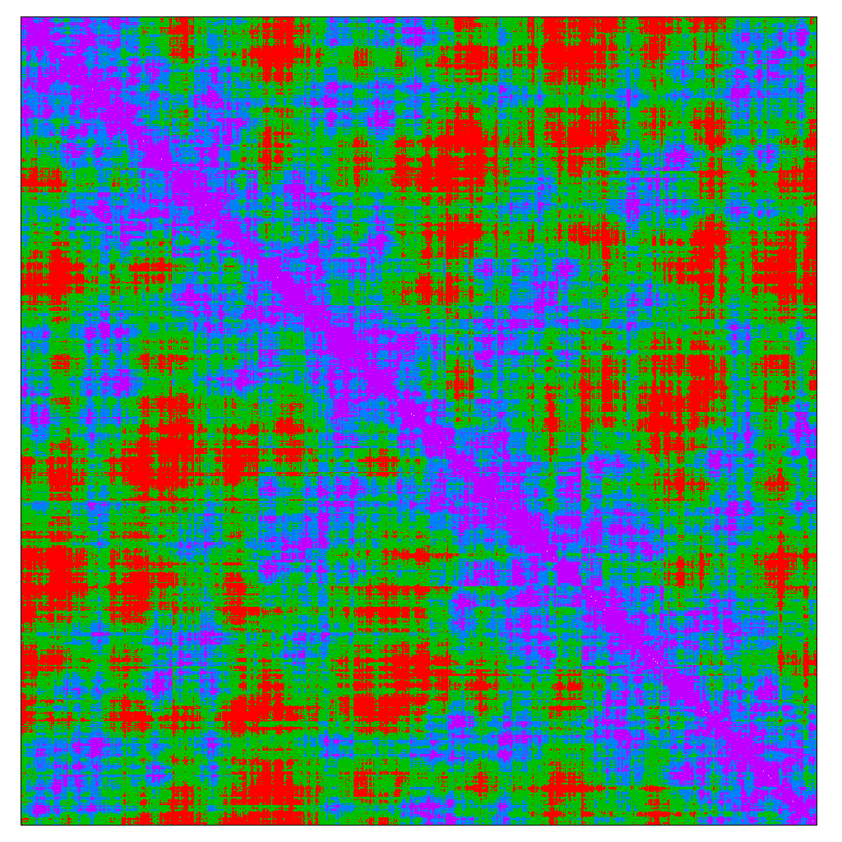
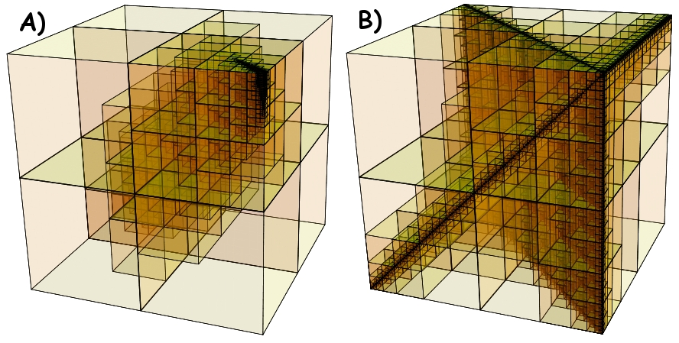
Matrix Multiplication as N-Body Solver
space filling curves
physics
locality principle
blocking
SpAMM: O(N) convolution with decay matrices
Large and Small Correlations in a
Data Local Matrix Quadtree (Decay Matrix)
fast algebra
Notes:
Apply space-filling curve ordering to atoms → clustering of matrix elements in electron density matrix.
Hierarchical bisection of density matrix → quadtree.
Matrix elements exhibit exponential or algebraic decay with spatial separation, leading to sparse matrix trees, and sparse product space, as shown on right (A is exponential, B is algebraic).
Typically an O(N) method would threshold matrix elements by magnitude leading to sparse matrix which can be multiplied in O(N) with a CSR/Gustavson approach.
SpAMM applies a threshold in product space (i.e. on the fly during the multiplication), to achieve adjustable product approximation and speed.

Slide 8
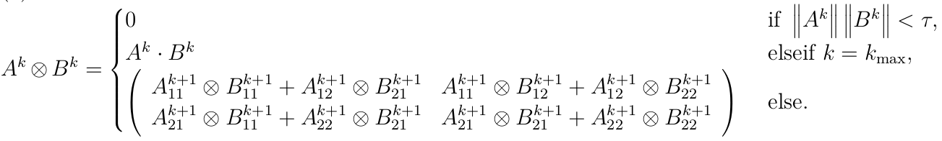
Matrix Multiplication as N-Body Solver
SpAMM is a fast kernel for multiplication of matrices with decay & structured locality. SpAMM is recursive occlusion and culling based on the Cauchy-Schwarz inequality, applied to data local matrix quadtrees:
Exponential Decay
Algebraic Decay
slower decay, still n-body

Slide 9
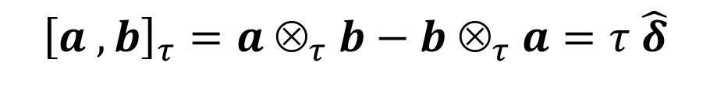
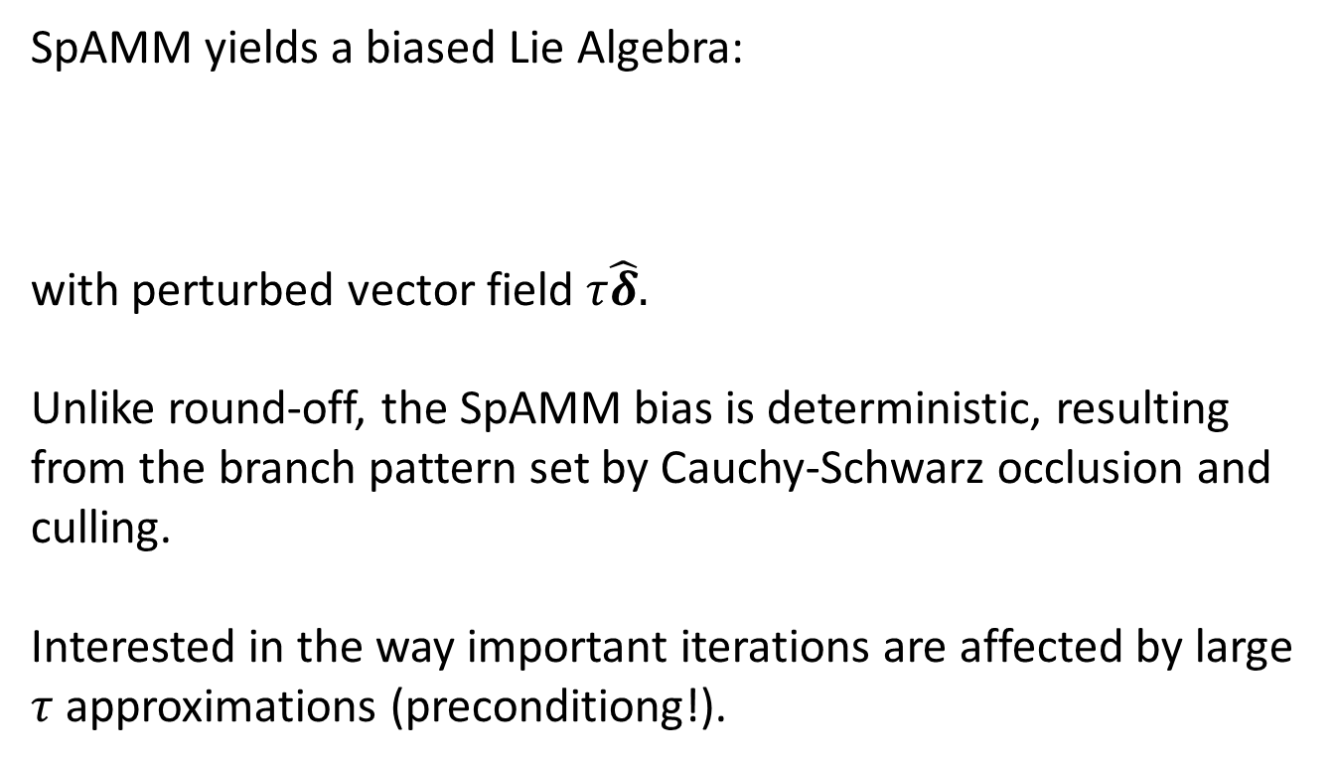

Groups+Perturbations, a SpAMM Algebra
SpAMM yields a biased Lie Algebra:
with perturbed vector field $τ\hat{δ}.$
Unlike round-off, the SpAMM bias is deterministic, resulting from the branch pattern set by Cauchy-Schwarz occlusion and culling.
Interested in the way important iterations are affected by large $τ$ approximations (preconditiong!).
$${\left[a , b\right]}_{τ}=a ⊗_{τ }b−b ⊗_{τ }a=τ \hat{δ}$$

Slide 10
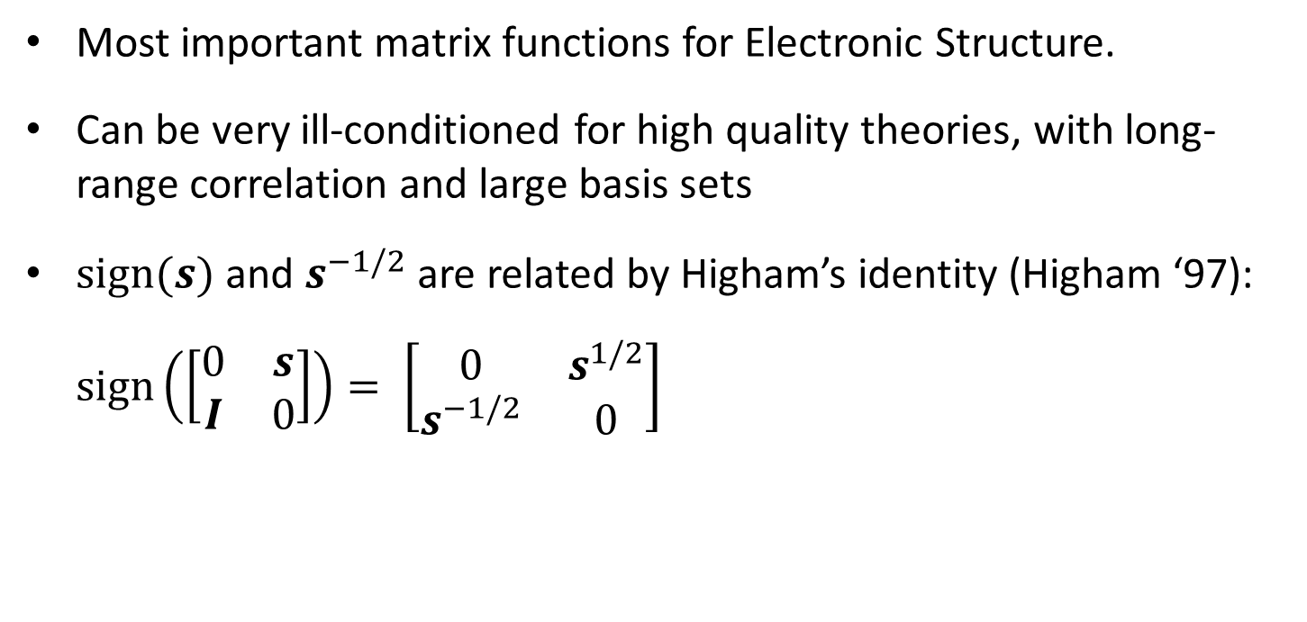
Newton Schulz for s ^{-1/2} and Sign(s)
Most important matrix functions for Electronic Structure.
Can be very ill-conditioned for high quality theories, with long-range correlation and large basis sets
$\text{s}\text{ign}(s)$and $s^{−1/2}$ are related by Higham’s identity (Higham ‘97):
$sign\left(\left[\begin{matrix}0 & s \\ I & 0\end{matrix}\right]\right)= \left[\begin{matrix}0 & s^{1/2} \\ s^{−1/2} & 0\end{matrix}\right]$
Many variations in literature. Error analysis focused almost entirely on the NS map.

Slide 11
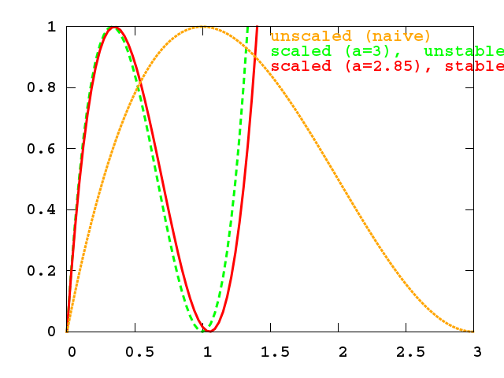


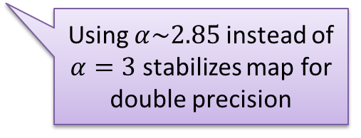
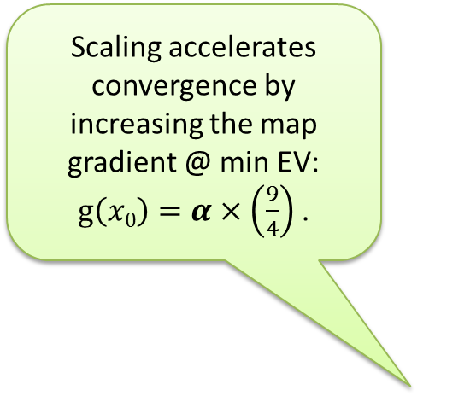
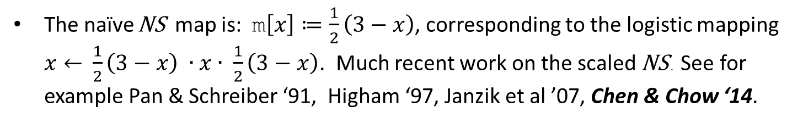
Scaled Newton Schulz
The naïve NS map is: $\text{m}\left[x\right]≔\frac{1}{2}\left(3−x\right)$, corresponding to the logistic mapping $x←$ $\frac{1}{2}\left(3−x\right) ∙x∙ \frac{1}{2}\left(3−x\right)$. Much recent work on the scaled NS . See for example Pan & Schreiber ‘91, Higham ‘97, Janzik et al ’07, Chen & Chow ‘14.
Scaling accelerates convergence by increasing the map gradient @ min EV: $g\left(x0\right)=α×\left(\frac{9}{4}\right)$.
Using $α\sim 2.85$instead of $α=3$ stabilizes map for double precision

Slide 12
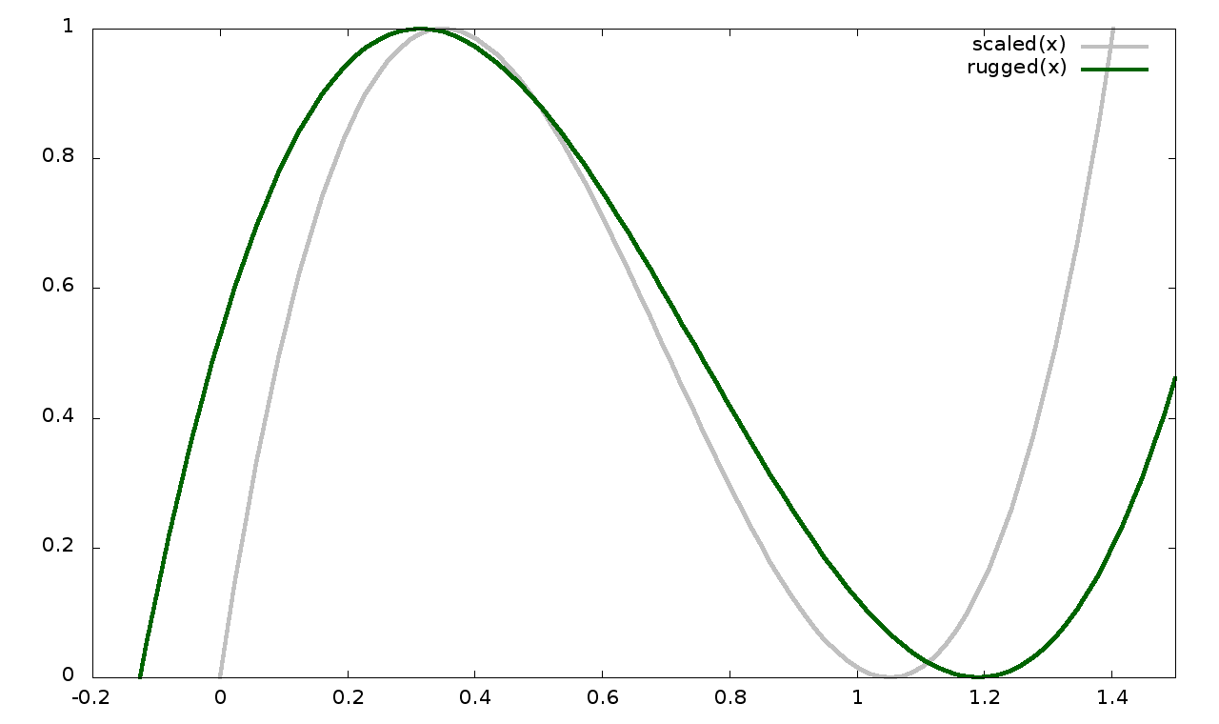


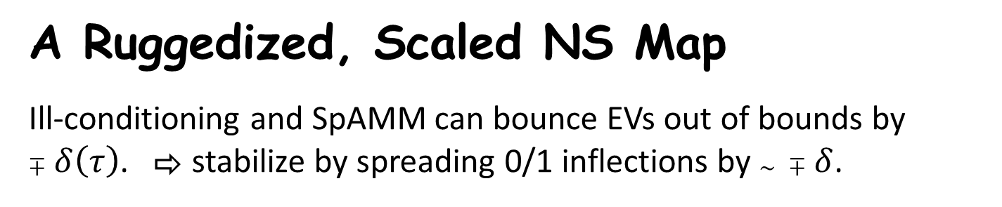
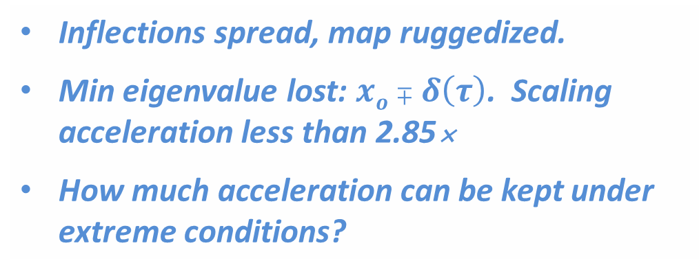
A Ruggedized, Scaled NS Map
Ill-conditioning and SpAMM can bounce EVs out of bounds by $∓δ\left(τ\right)$. ⇨ stabilize by spreading 0/1 inflections by $\sim ∓δ$.
Inflections spread, map ruggedized.
Min eigenvalue lost: $xo∓δ\left(τ\right)$. Scaling acceleration less than 2.85
How much acceleration can be kept under extreme conditions?

Slide 13
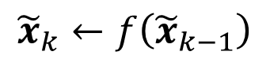
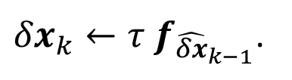
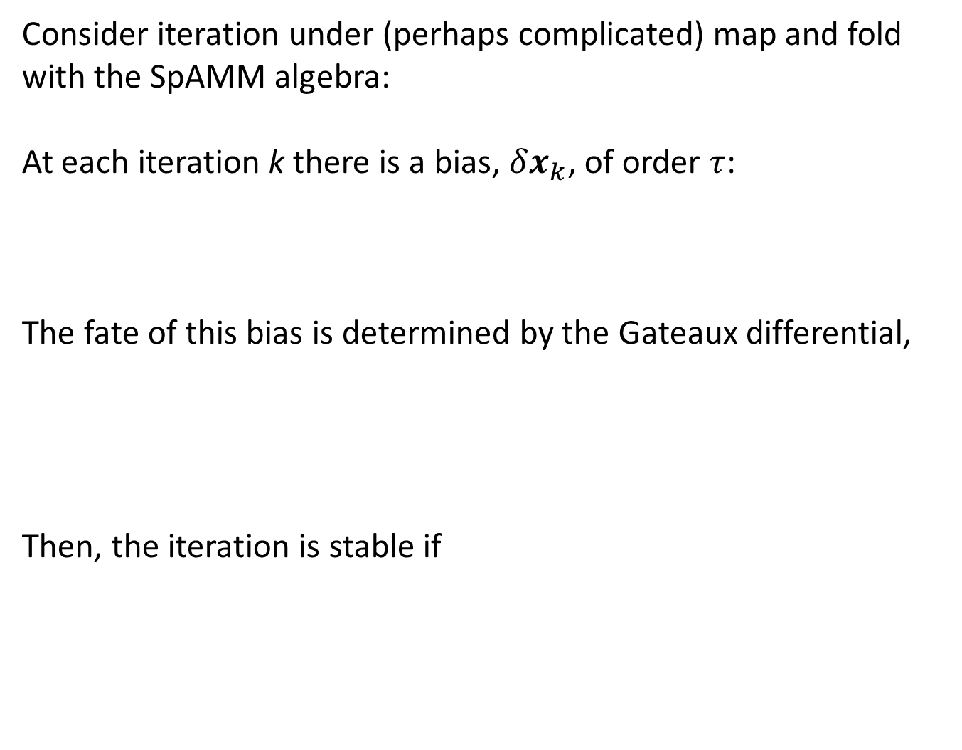
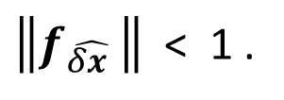
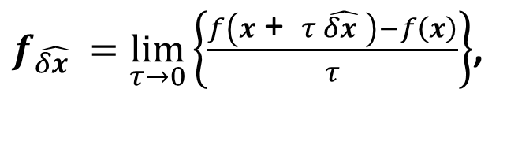
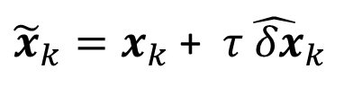
Bias Stability Under SpAMM Iteration
Consider iteration under (perhaps complicated) map and fold with the SpAMM algebra:
At each iteration k there is a bias, $δx_{k}$, of order $τ$:
The fate of this bias is determined by the Gateaux differential,
Then, the iteration is stable if
$${\tilde{x}}_{k}←f\left({\tilde{x}}_{k−1}\right)$$
${\tilde{x}}_{k}=x_{k}$ + $τ{\hat{ δx}}_{k}$
$f_{\hat{δx }}=\lim_{τ→0}\left\{\frac{f\left(x\text{ + }τ \hat{δx }\right)−f\left(x\right)}{τ}\right\}$,
via
${δx}_{k}←τ$ $f_{{\hat{δx}}_{k−1}}$.
$\left\|f_{\hat{δx }}\right\|$ < 1 .

Slide 14
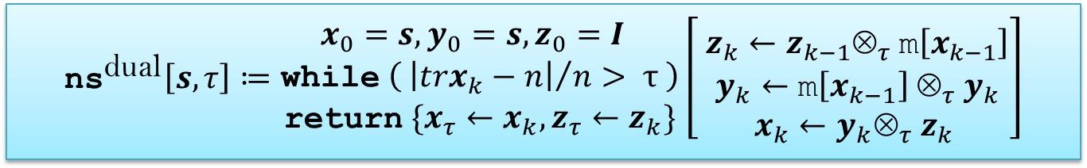
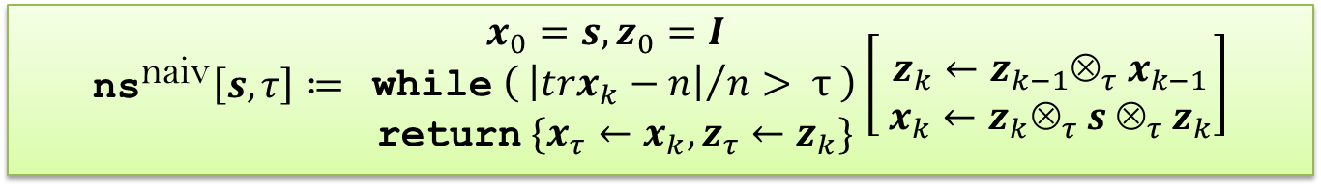
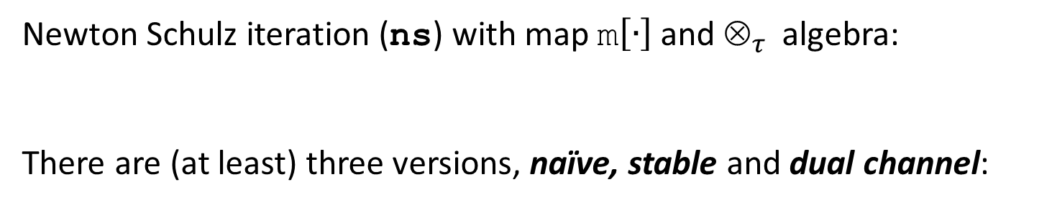
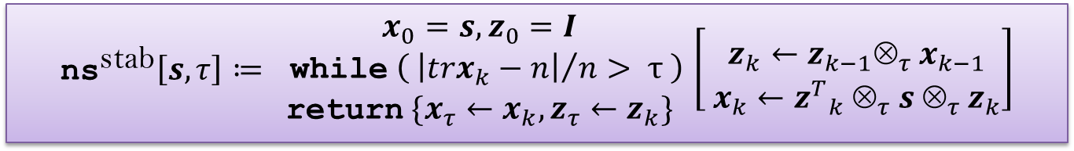
Scaled Newton Schulz Iterations (Three)
Newton Schulz iteration ($\text{ns}$) with map $\text{m}\left[∙\right]$and $_{τ }$ algebra:
There are (at least) three versions, naïve, stable and dual channel:
$$\left\{x_{τ},z_{τ}\right\}←\text{ns}\left[s, τ\right], \text{with} x_{τ}→I \text{and}{ z}_{τ}→s^{−1/2} \text{as} τ →0$$
$${\text{ns}}^{\text{naiv}}\left[s, τ\right]≔ \begin{matrix}x_{0}=s, z_{0}=I \\ \text{while} \left( {\left|trx_{k}−n\right|}/n> τ \right) \\ \text{return} \{x_{τ}←x_{k},{z_{τ}←z}_{k}\}\end{matrix}\left[ \begin{aligned} \\ z_{k}←z_{k−1}⊗_{τ }x_{k−1} \\ x_{k}←z_{k}⊗_{τ }s ⊗_{τ }z_{k}\end{aligned}\right]$$
$${\text{ns}}^{\text{stab}}\left[s, τ\right]≔ \begin{matrix}x_{0}=s, z_{0}=I \\ \text{while} \left( {\left|trx_{k}−n\right|}/n> τ \right) \\ \text{return} \{x_{τ}←x_{k},{z_{τ}←z}_{k}\} \end{matrix}\left[ \begin{aligned} \\ z_{k}←z_{k−1}⊗_{τ }x_{k−1} \\ x_{k}←{z^{T}}_{k}^{} ⊗_{τ }s ⊗_{τ }z_{k}\end{aligned}\right]$$
$${\text{ns}}^{\text{dual}}\left[s, τ\right]≔\begin{matrix}x_{0}=s, y_{0}=s,z_{0}=I \\ \text{while} \left( {\left|trx_{k}−n\right|}/n> τ \right) \\ \text{return} \{x_{τ}←x_{k},{z_{τ}←z}_{k}\}\end{matrix}\left[\begin{aligned} \begin{aligned} \\ z_{k}←z_{k−1}⊗_{τ }\text{m}\left[x_{k−1}\right] \\ y_{k}←\text{m}\left[x_{k−1}\right]{ ⊗}_{τ }y_{k}\end{aligned} \\ x_{k}←y_{k}⊗_{τ }z_{k}\end{aligned}\right]$$

Slide 15
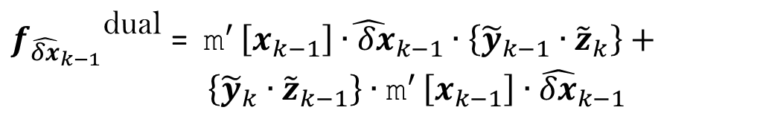
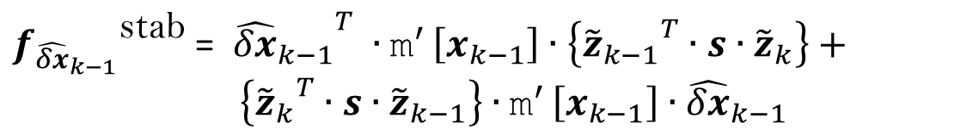
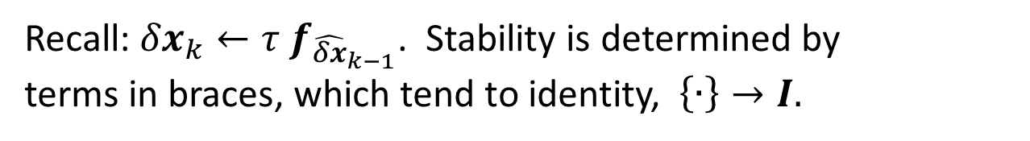
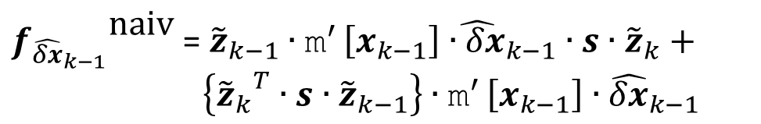
Gateaux Differentials and Stability
Recall: ${δx}_{k}←τ$ $f_{{\hat{δx}}_{k−1}}$. Stability is determined by
terms in braces, which tend to identity, $\left\{∙\right\}→I.$
${f_{{\hat{δx}}_{k−1}}}^{\text{naiv}}$ = ${\tilde{z}}_{k−1}∙{\text{m}}^{′ }\left[x_{k−1}\right]{\hat{∙δx}}_{k−1}∙s∙{\tilde{z}}_{k}+ \left\{{{\tilde{z}}_{k}}^{T}∙s∙{\tilde{z}}_{k−1}\right\}∙{\text{m}}^{′ }\left[x_{k−1}\right]∙{\hat{δx}}_{k−1}$
This term is pathological.
${f_{{\hat{δx}}_{k−1}}}^{\text{stab}}$ = ${{\hat{δx}}_{k−1}}^{T} ∙{\text{m}}^{′ }\left[x_{k−1}\right]∙\left\{{{\tilde{z}}_{k−1}}^{T}∙s∙{\tilde{z}}_{k}\right\}+ \left\{{{\tilde{z}}_{k}}^{T}∙s∙{\tilde{z}}_{k−1}\right\}∙{\text{m}}^{′ }\left[x_{k−1}\right]∙{\hat{δx}}_{k−1}$
These terms tend to I and remain near s.
These terms should tend to I , but have problems b/c they do not remain near s.
${f_{{\hat{δx}}_{k−1}}}^{\text{dual}}$ = ${\text{m}}^{′ }\left[x_{k−1}\right]{\hat{∙δx}}_{k−1}∙\left\{{\tilde{y}}_{k−1}∙{\tilde{z}}_{k}\right\}+ \left\{{\tilde{y}}_{k}∙{\tilde{z}}_{k−1}\right\}∙{\text{m}}^{′ }\left[x_{k−1}\right]∙{\hat{δx}}_{k−1}$

Slide 16
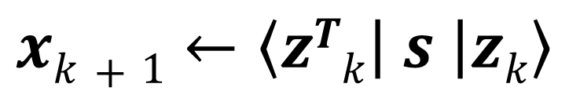
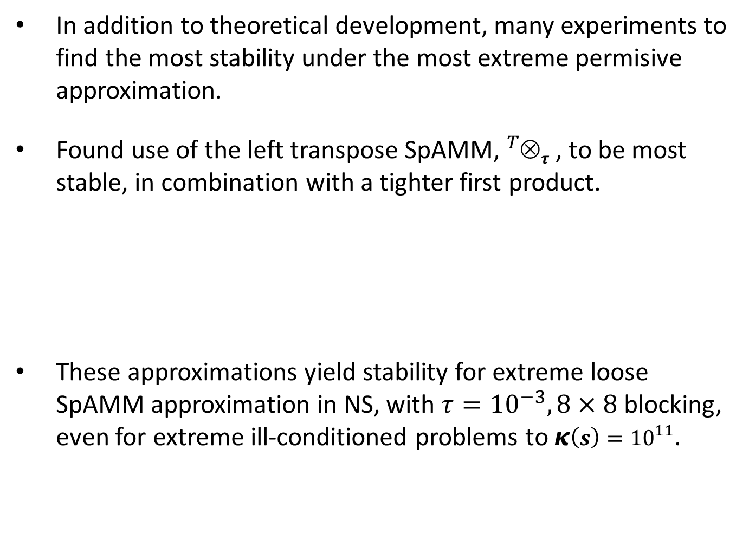
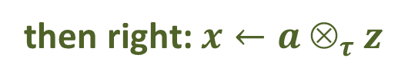
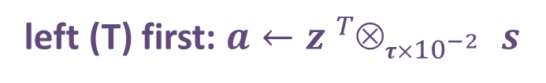
SpAMM Stabilized Scaled NS
In addition to theoretical development, many experiments to find the most stability under the most extreme permisive approximation.
Found use of the left transpose SpAMM, ${}_{}^{T}{_{τ }}$, to be most stable, in combination with a tighter first product.
These approximations yield stability for extreme loose SpAMM approximation in NS, with $τ={10}^{−3}, 8×8$ blocking, even for extreme ill-conditioned problems to $κ\left(s\right)={10}^{11}$.
$$xk+1←\left\langle zTk | s | zk\right\rangle$$
then right: $x←a _{τ }z$
left (T) first: $a←z {{}_{}^{T}{_{τ×{10}^{−2} }}}_{ }s$

Slide 17
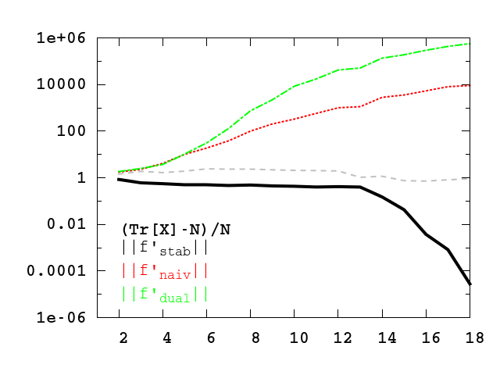
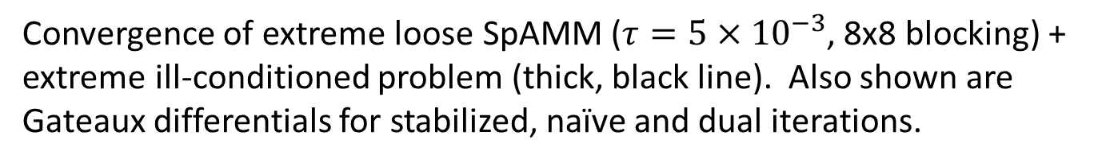
Ill-Conditioning: $κ\left(s\right)={10}^{11},$ (3,3)x8 nanotube
Convergence of extreme loose SpAMM ($τ=5{ ×10}^{−3}$, 8x8 blocking) + extreme ill-conditioned problem (thick, black line). Also shown are Gateaux differentials for stabilized, naïve and dual iterations.

Slide 18
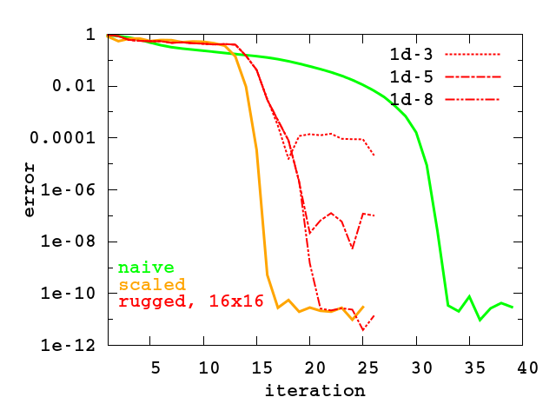
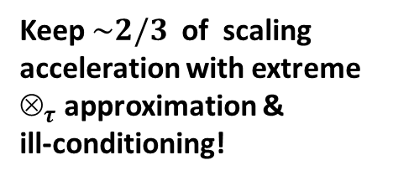
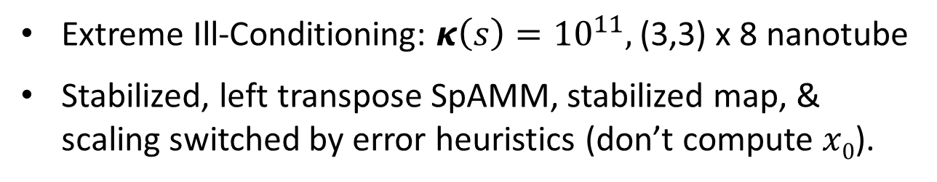
SpAMM Stabilized Scaled NS
Extreme Ill-Conditioning: $κ\left(s\right)={10}^{11},$ (3,3) x 8 nanotube
Stabilized, left transpose SpAMM, stabilized map, & scaling switched by error heuristics (don’t compute $x0$).
Keep $\sim 2/3$ of scaling
acceleration with extreme $_{τ }$approximation & ill-conditioning!

Slide 19
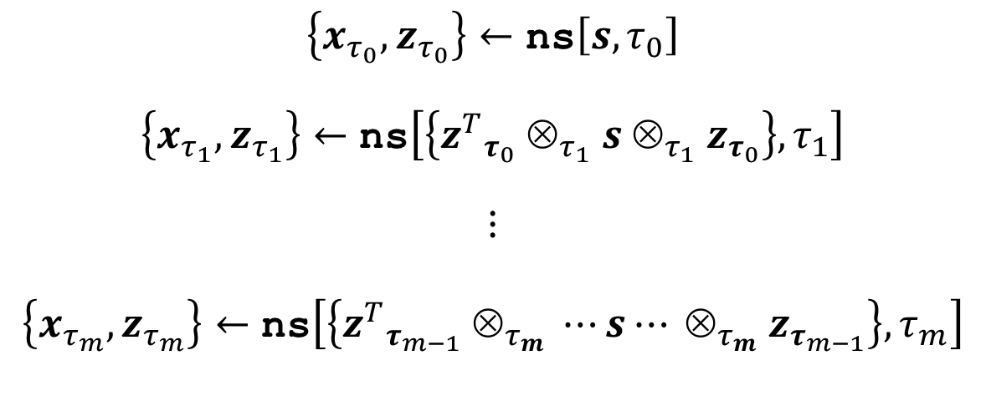
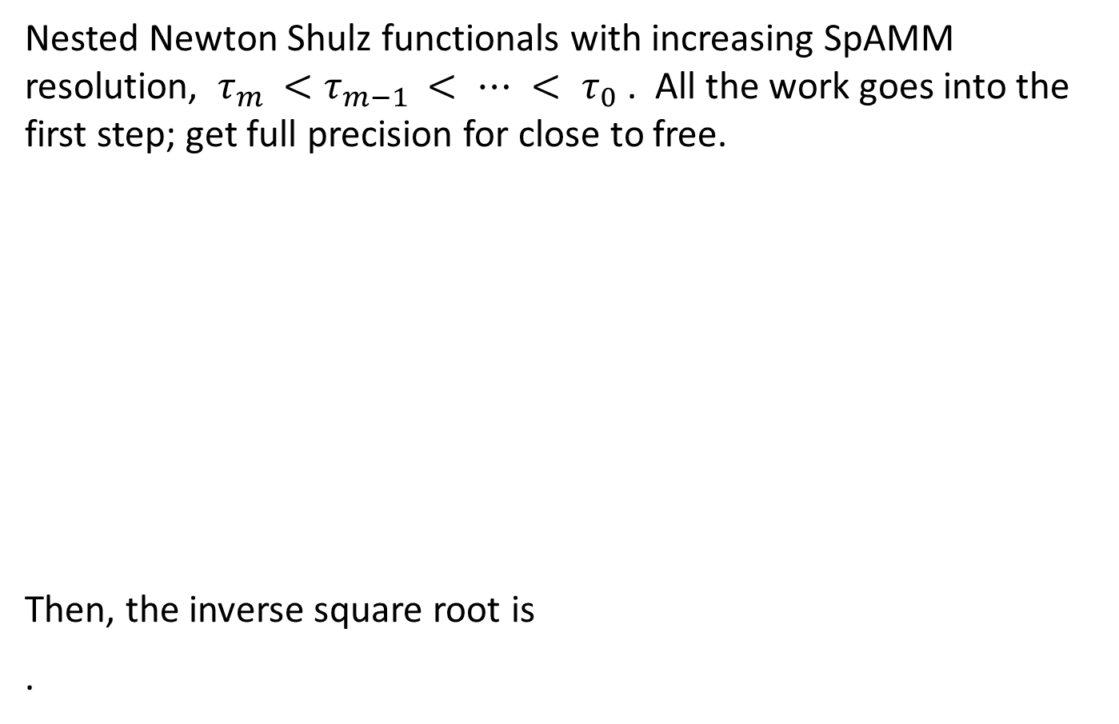
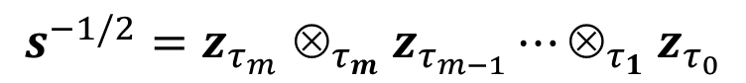
Recursive Preconditioning: The SpAMM Sandwich
Nested Newton Shulz functionals with increasing SpAMM resolution, $τ_{m }<τ_{m−1 }< ⋯ < τ_{0}$ . All the work goes into the first step; get full precision for close to free.
Then, the inverse square root is
.
$$\begin{matrix}\begin{aligned}\left\{x_{τ_{0}},z_{τ_{0}}\right\}←\text{ns}\left[s,τ_{0}\right] \\ \end{aligned} \\ \begin{aligned}\left\{x_{τ_{1}},z_{τ_{1}}\right\}←\text{ns}\left[\left\{{z^{T}}_{τ_{0}}^{} ⊗_{τ_{1} }s ⊗_{τ_{1} }z_{τ_{0}}\right\},τ_{1}\right] \\ \end{aligned} \\ \begin{aligned}\begin{aligned}⋮ \\ \end{aligned} \\ \begin{aligned}\left\{x_{τ_{m}},z_{τ_{m}}\right\}←\text{ns}\left[\left\{{z^{T}}_{τ_{m−1}}^{} ⊗_{τ_{m} }⋯s⋯ ⊗_{τ_{m} }z_{τ_{m−1}}\right\}, τ_{m}\right] \\ \end{aligned}\end{aligned}\end{matrix}$$
$$s^{−1/2}{=z}_{τ_{m}}{_{τ_{m} }z}_{τ_{m−1}}⋯{_{τ_{1} }z}_{τ_{0}}$$

Slide 20
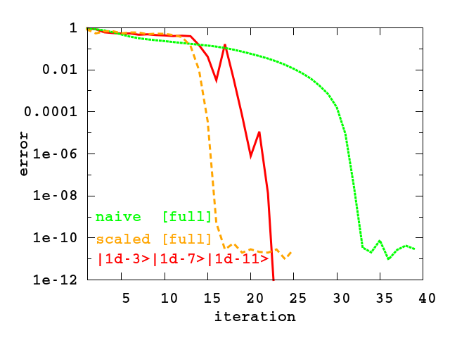
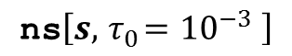
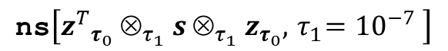
Ill-Conditioning: $κ\left(s\right)={10}^{11},$ (3,3)x8 nanotube
$$\text{ns}\left[s, { τ}_{0}={10}^{−3} \right]$$
$$\text{ns}\left[{z^{T}}_{τ_{0}}^{} ⊗_{τ_{1} }s ⊗_{τ_{1} }z_{τ_{0}},{ τ}_{1}={10}^{−7} \right]$$
$$\text{ns}\left[{z^{T}}_{τ_{1}}^{} ⊗_{τ_{2} }{z^{T}}_{τ_{0}}^{} ⊗_{τ_{1} }s {⊗_{τ_{1} }z_{τ_{0}}⊗}_{τ_{2} }z_{τ_{1}},{ τ}_{2}={10}^{−11} \right]$$

Slide 21
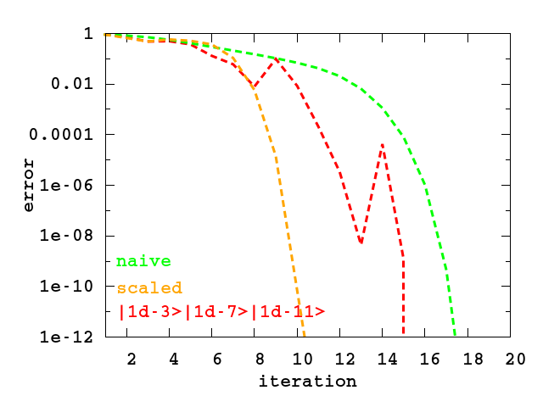
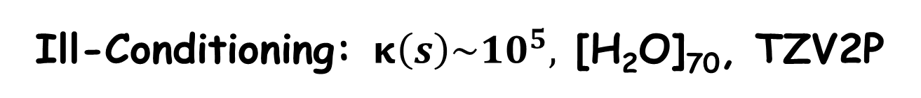
Ill-Conditioning: $κ\left(s\right)\sim {10}^{5},$ [H₂O]₇₀, TZV2P
With recursive preconditioning, one resolutions accuracy is another’s error!

Slide 22
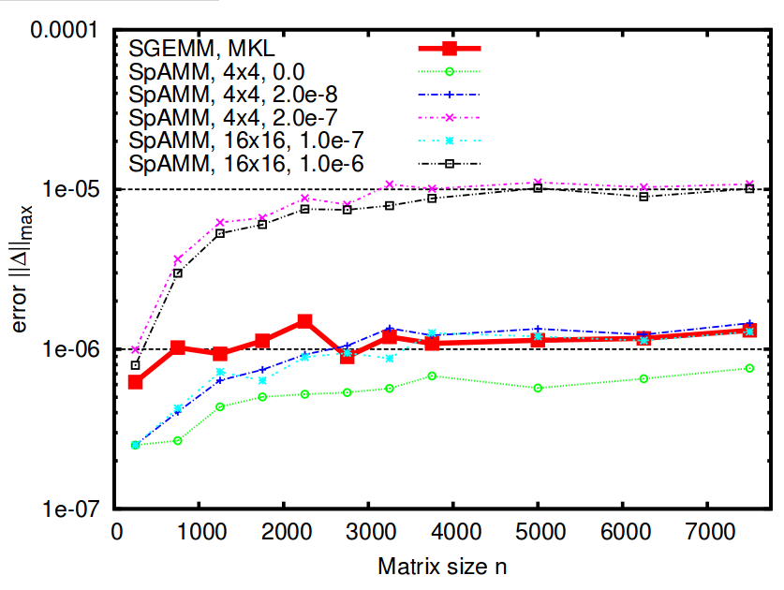
SpAMM For Dense Decay Matrices
Bock & Challacombe, SIAM J. Sci. Comput., 35(1), C72
Product matrix is asymptotically sparse, but only much, much later
Fill in of small blocks at negligible cost yields O (N ) scaling even for dense matrices
In single, SpAMM beats MKL SGEMM in error
Recursion w/locality more accurate than row-column

Slide 23
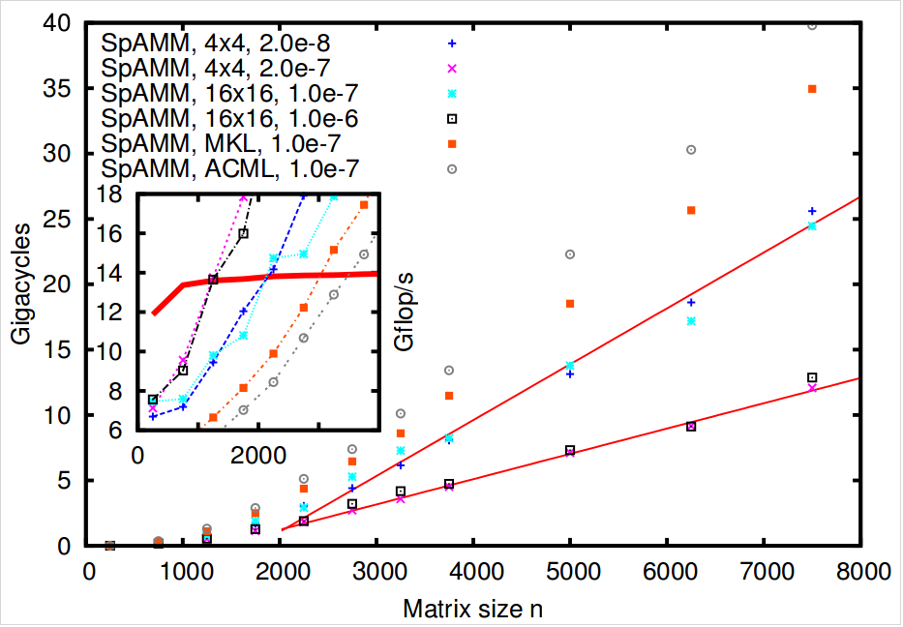
What About an Optimized SpAMM?
Bock & Challacombe, SIAM J. Sci. Comput., 35(1), C72
Assembly coded SpAMM in single. Don’t try this at home… Informs use of pragmas, OpenMP 4.0 directives & etc.
50% of peak with 4x4 blocking
Crossover with MKL/SGEMM at N=2000, same error
Can we do as well with directives (openmp 4)?
6-31G**, SpAMM of
Spectral Projector

Slide 24
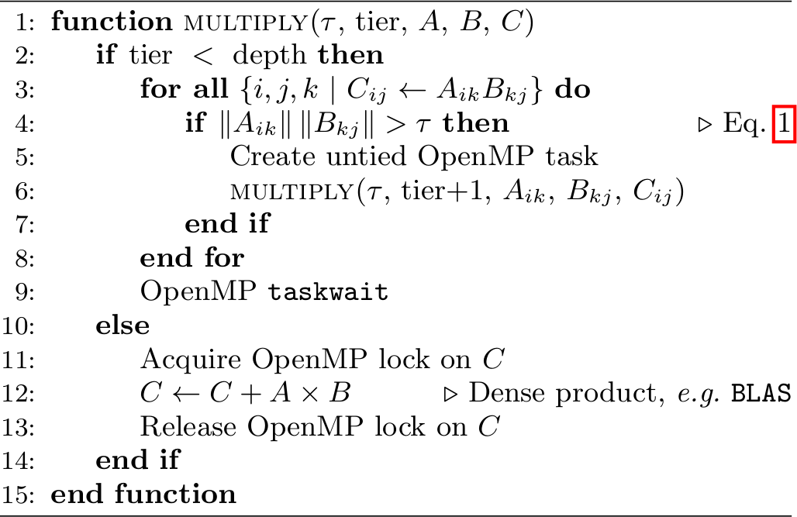
SpAMM – OpenMP 3.0
Notes:
Very simple programming model

Slide 25


SpAMM with OpenMP3 and OpenMP4
OpenMP3 work very well with recursive task parallelism and atomic operations. Hardware support will improve performance.
OpenMP4 may allow high performance for SIMD pipelines (ongoing). Our studies suggest 50% of peak possible even for very fine granularities (4x4).
Magny Cours (AMD)
Xeon Phi (Intel-MIC)
Hyperthreading beyond 60 cores
Notes:
Parallel performance scales almost ideally on 4 socket AMD 12-core system, up to 48 cores.

Slide 26

Weak Scaling and the Parallel SpMM
Bowler et. al, arXiv:1402.6828 ← very entertaining comment …
So far, no code has demonstrated a parallel SpMM beyond ~ 4 atoms/core (p < N/4). While enabling bigger systems, does not enable high throughput (timesteps!)
Best results to date involve work homogenization and Cannon’s method, precluding p >> N.
Argue that no SpMM employing matrix decomposition can be O (N ) & access strong scaling limit

Slide 27
SpAMM in the Strong Scaling Limit
Bock & Challacombe, SIAM J. Sci. Comput, to be accepted w/revs 2015
Quantum locality → data locality via SFC heuristics
Decomposition in 3-D task space, not in the sparse 2-D data space
Common runtimes that support recursive task parallelism (openmp/smp) and persistence based load balancing (charm++/distributed)
Parallel scaling studies of functional approximation by iteration, for spectral projection (sign/step function).
first iteration is dynamically balanced, then with persistence load balancing after.

Slide 28








Dynamic and Persistence Load Balancing in SpAMM Spectral Projection (Sign Function)
$$_{τ={10}^{−6} }$$
$$_{τ={10}^{−10} }$$
first step
first step
$$_{τ={10}^{−6} }$$
$$_{τ={10}^{−10} }$$
final step
$\sim 5$00 cores/ heavy atom. Compare vs 4 heavy atoms/core!
final step
Notes:
24 cores per node
Total of 1024 nodes = 24,576 cores
Biggest machine LANL has (outside classified)
LB is nicely balancing everything after only 2-3 iterations
A total of about 40 iterations is needed for convergence

Slide 29


Perfectly Strong Scaling & Communications Optimality
The Yelick and Demmel groups at Berkeley are hot on the trail of communication optimality for n-body interactions and perfect strong scaling for recursive matrix multiplication. Maybe we can do better still for SpAMM?

Slide 30

Metric Learning in Genomics
Consider phylogenetic classification and metagenome resolution based on k-mer frequency vectors of dimension $n=4^{k}.$ K-mers are nucleotide strings of length k, widely available with modern technology.
Define the generalized inner product between k-mer frequency vectors, ${〈x, x^{′}〉}_{M}=x^{∗}∙M∙x^{′}$. Then, the corresponding generalized distance is ${\left\|x−y\right\|}_{M}=\sqrt{{\left(x−y\right)}^{∗}∙M∙\left(x−y\right)\text{.}}$
Objective: Classification and resolution based on the learned metric M (novel).
Challenge: Exponential growth as $n=4^{k}$, with unique sequences only starting to appear for$k>11$.

Slide 31




Learning the Mahalanobis Metric with Convex Optimization
$$\min_{M}\left[\sum_{x,y∈𝓢}{\left.{〈x−y, x−y〉}_{M}\right.}−\sum_{x,y∈𝓓}{{〈x−y, x−y〉}_{M}}\right] \text{s}\text{.}\text{t}\text{. }M≽0 \& \text{tr}\text{M}\text{ =1}$$
Maintain M Hermetian, positive semidefinite, and scale invariant
Minimize distances between similar vectors ($𝓢$)
Maximize distances between dissimilar vectors ($𝓓$)
Can solve this problem with Semi-Definite Programming (SDP) in $O\left(m^{2}n^{2}+n^{3}\right)$, where m is the training set size, and n is the matrix (learning) dimension.
Reduce the cost from $O\left(n^{3}\right)$to $O\left(n\right)$ with SpAMM and gradients only approach to SDP.

Slide 32
Metric Classification of Unknowns with k=5
Faux Unknown | Closest training set genomes | Distance
F. tularensis subsp. tularensis FSC198 | Francisella tularensis subsp. tularensis Schu S4 | 5.17e-11
 | Francisella tularensis subsp. mediasiatica FSC147 | 2.69e-08
 | Francisella tularensis subsp. tularensis WY96-3418 | 2.75e-08
 | Francisella tularensis subsp. holarctica FTNF002-00 | 7.01e-08
 | Francisella tularensis subsp. holarctica OSU18 | 1.12e-07
 | Francisella tularensis subsp. holarctica LVS | 1.29e-07
 | Francisella novicida U112 | 2.44e-07
 | Francisella philomiragia ATCC 25017 | 1.51e-05
phylogentic tree of genomes (as vectors)
learn M
(SDP solver)
unknown
classification
distances

Slide 33

Metric Classification of Unknowns with k=5
Test: train with just 5 genomes (simple but hard)
correctly classify 5 fake unknowns
Get better resolution with larger training sets and larger k

Slide 34




SpAMM & Gradients only SDP for k>>5 ?
To maintain M ≽ 0 with gradients only, need to solve the line search problem: $\min_{α}{f(P_{+}\left[M+α∇f\left(M\right)\right])}.$ Use fast methods to find the spectral projector $P_{+}\left[M\right].$ Works crudely.
M is a correlation matrix, so expect (and find) decay properties. Better locality heuristics for k-mers will enhance SpAMM acceleration
learned M, $k=5$, 54 genomes, 18 classes
SpAMM acceleration vs. SGEMM
acceleration
$$τ$$

Slide 35
Solver Ecosystems Towards Materials Design
PHYSICS: Strong Correlation
single determinant KSTs. Correlation on top of Fock exchange, eg. B13.
toward Mott transition, ill-conditioned matrix functions
MATH: Functional Approximation
nested approximate algebras and recursive preconditioning.
ill-conditioned matrix functions
N-BODY SOLVERS: Generalized Thin Stacks
N-Body Fock exchange (NoFX)
N-Body Linear Algebra (SpAMM)
many others …
InfoSci: N-Body Learning
fast kernel summation.
metric learning: fast approaches to linear algebra including semi definite programming.
CompSci: Generic Programming
functional programming, skeletons, recursive task parallelism, openmp 4.
enterprise frameworks: scala/spark + neo/epiphany/phi.

Slide 36




Enterprise Trends for Solver Ecosystems
Towards generic and communication optimal solver collectives
Leverage disruptive technologies along the commodity trend: enterprise frameworks like spark, and the cost deflation of decentralized resources like EC2 cloud.
distributed task and vector parallelism under openmp 4.0
decentralized, generic parallelism, via eg. scala/spark
thin, generalized stacks for n-body collectives
$O\left(Nx\right)$ $→O\left(N\right)$ $→\frac{5GF}{Watt}O\left(N/p\right)→\frac{100GF}{Watt}O\left(N/p\right)$
ecosystems
of generalized
n-body solvers
[freeon.org]
massively MIMD: phi, neo & epiphany
enterprise runtimes ,
frameworks & commodity cloud hardware

